Slide 1
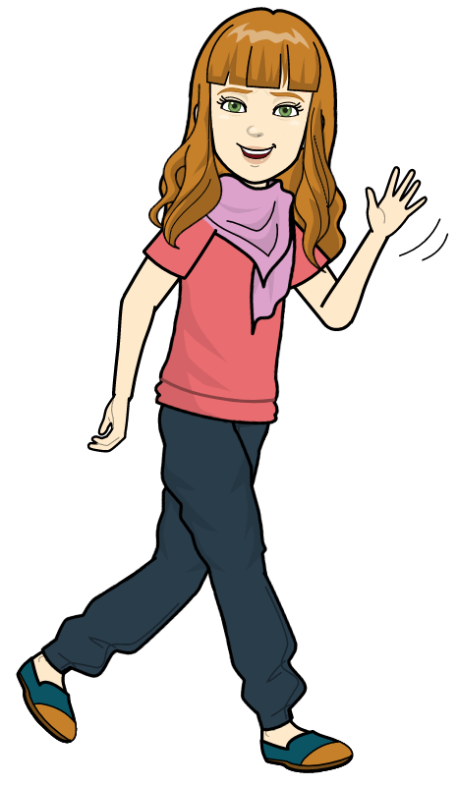
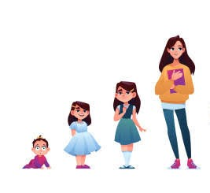
Growing Up
By Ahiave Kekeli ahive
LUC/FCSMM/DSE/04/0031

Slide 2
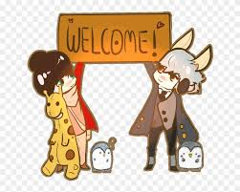
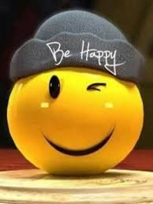
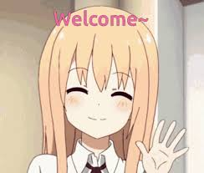

iNtRO:
Hi there, I’m Elle, I’m 20 and I am currently In college, USC to be precise. I’m studying Video Game design. Well I am here to tell you a story of me growing up.
So let’s Begin

Slide 3
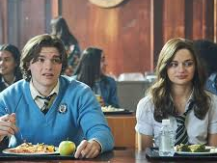
The Beginning
It was on the 22nd of February 2002 at a hospital in LA and at the same time my mom’s best friend gave birth at the very exact time so her son and I became birthday twinness, it was so cute and since they were besties and the birth thing, that is how I got to meet my best friend in the “Whole” world Lee Neville.
We did everything together, went to the same school, spent our Holidays together, and we were always there for each other. We had rules as best friends which was our guide our relationship. Well that was all going to change as we got to High School, all because “Love”

Slide 4
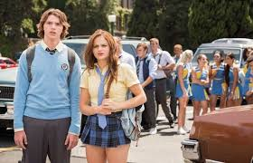
HIGH SCHOOL Part 1
Well it all started when we got to our new school where also my bestie’s elder brother schools, well that was expected but all was good as far as I don’t break #RULE 7 “Don’t date your besties relatives. "The year was moving on kinda ok until Lee and I were tasked with a fundraiser idea for the school’s Anniversary. We thought for days on what the students will like, how acceptable it will be, etc. Well all ideas were either rejected by the Student board for being to ordinary, saying we’re not thinking outside the box. Well we hit a wall at that point. Then on deadline day it hit me let’s organize a kissing booth .Well the idea was accepted by all but the problem was to get the participants. The students all gave conditions or excuses it was so frustrating. So Lee and I became the participants for the booth.

Slide 5

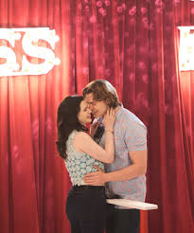
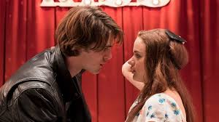
High School
Part 2
On the day of the it which held, in the evening all was setup and the time came, I haven’t kissed anyone in my life and I was about to kiss a few people, I was really nervous. Time came and everyone was there but no one was actually wanting to come, I was blindfolded and I really felt awkward when no one came forth . Feeling down casted I was about to close it down then someone said he will like a kiss. I told him am not joking, I haven’t kissed anyone before and am shy, before I could list more reasons why he shouldn’t, he kissed me. I couldn’t explain it, but it was perfect just the way I imagined it, dreamy perhaps. His gesture made the everyone look at us in awe everything was going great. Only for me to pull the blindfold and find out is my bestie's elder bro, Noah.😱😰😨.

Slide 6
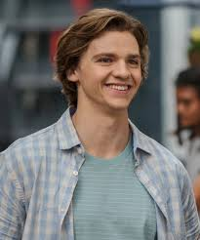
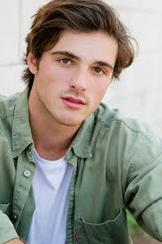
Conflictions
Don’t Know What To Do
Lee was so disappointed with me, that I broke a rule. I thought it was childish because you can’t control your feelings but he said why Noah out of everyone why him. I said I don’t know why but it just feels right.
Well as the blind fold removed I was perplexed but unusually calm about it, but what he said just sunk me into confusion. He said that he started having feelings for me since I got in that he couldn’t see me as a little kid sis anymore. He confessed his feelings in front of everyone he said “I Love You”.

Slide 7
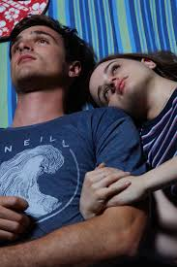
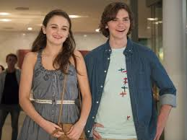
choices
Well I don’t know what to do. I haven’t spoken to any of them because I don’t know what to say that I should choose my best friend over love or vice versa. Then college is around the corner and they are asking me to write an essay on who I want to be in five years, when I don’t know who I am now.

Slide 8
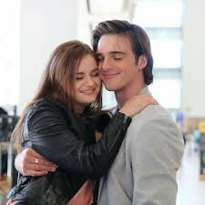
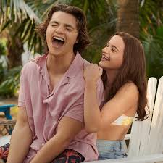
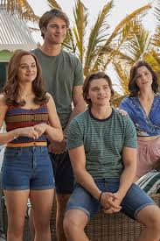
Apologies
Well after a week of thinking about everything retrospectively I decided on two things I should tell Lee what really happened and tell him how I truly felt about Noah. I do love him a lot but my best friend deserves the truth.
I told him everything he was mad but he understood and I assured him that he will never be sidelined he will always be my best friend forever.
Well about Noah since I loved him too I said yes too, at that point every thing was seriel and everyone was happy.

Slide 9
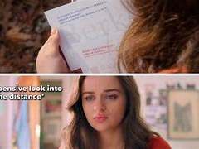
Realization
Well after all that, I realized what I want to write about. What I want to be in five years is still hazy to me. Most kids my age are still trying to figure it out, maybe it’s because it not what I want to be but who I want to be, Because from what I learnt in high school, random things happen to anyone nothing planned is actually followed so in five years I want to be my brothers joy, my father’s Love, my mom’s warmth, in five years I want to be Amie’s kindness, Noah’s courage, his mom’s wisdom but most of all I want to be my best friend's laughter. All those things together is who I want to be in five years. Well anything aside from that will have to wait till I get there.

Slide 10
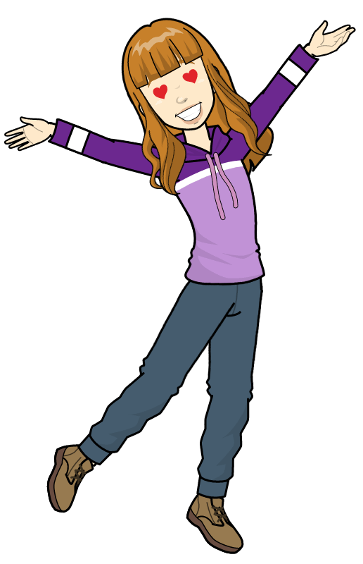
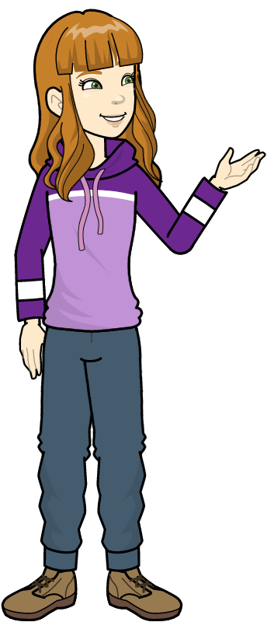
The story has now come to an end see you later
Live with a smile😀😀
The
End

